Slide 1
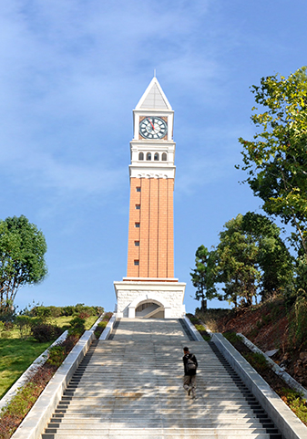
工作会议
20XX
工作汇报

Slide 2
目录/CONTENTS
01
02
03
04
输入标题
输入标题
输入标题
输入标题
点击输入文本内容点击输入文本内容点击输入文本内容点击输入文本内容
点击输入文本内容点击输入文本内容点击输入文本内容点击输入文本内容
点击输入文本内容点击输入文本内容点击输入文本内容点击输入文本内容
点击输入文本内容点击输入文本内容点击输入文本内容点击输入文本内容

Slide 3
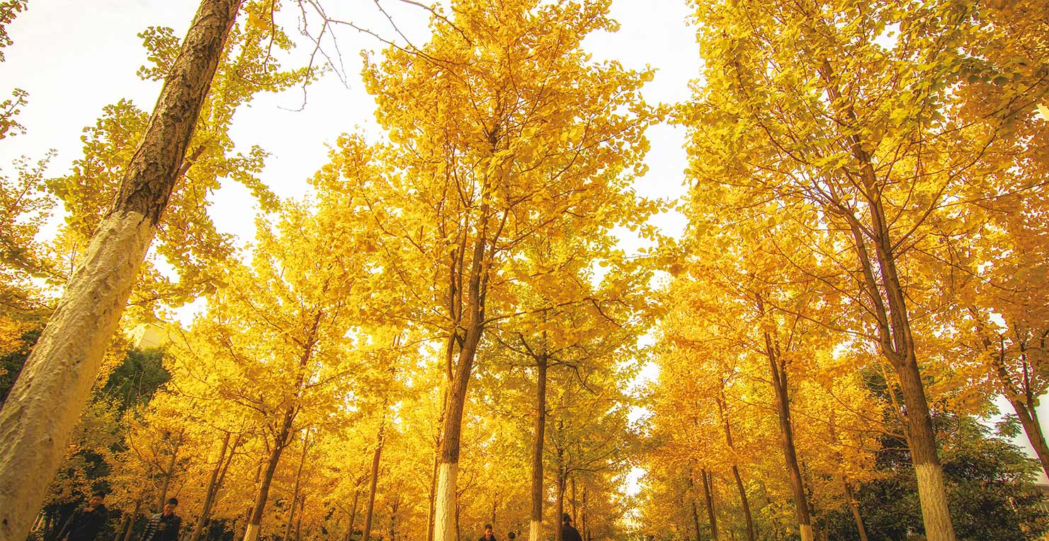
01
年度工作概述
The user can demonstrate on a projector or computer, or print the presentation and make it into a film to be used in a wider

Slide 4
年度工作概述
print the presentation and make it into a film a wider field
标题文字添加
The user can demonstrate on a projector or computer, or print the presentation and make it into a filmThe user can demonstrate on a projector or computer, or print the presentation and make it into a filmThe user can demonstrate on a projector or computer, or print the presentation and make it into a film
文字添加
文字添加
文字添加

Slide 5
年度工作概述
print the presentation and make it into a film a wider field
标题文字添加
标题文字添加
computeror print the presentation and make it film to be used in a wider field
computeror print the presentation and make it film to be used in a wider field
标题文字添加
标题文字添加
computeror print the presentation and make it film to be used in a wider field
computeror print the presentation and make it film to be used in a wider field

Slide 6
年度工作概述
print the presentation and make it into a film a wider field
标题文本预设
标题文本预设
标题文本预设
标题文本预设
标题文本预设
标题文本预设
标题文本预设
标题文本预设
标题文本预设
标题文本预设
标题文本预设
标题文本预设
标题文本预设
标题文本预设
标题文本预设
标题文本预设
标题文本预设

Slide 7
年度工作概述
print the presentation and make it into a film a wider field
关键词
关键词
关键词
标题文字添加此处
The user can demonstrate on a projector or computer, or print the presentation and make it into a film to be used in a wider fieldThe user can demonstrate on a projector or computer, or print the presentation and make it into a film to be used in a wider field

Slide 8
年度工作概述
print the presentation and make it into a film a wider field
标题文字添加
标题文字添加
标题文字添加
标题文字添加
The user can demonstrate on a projector or computer, or presentation and make it film to be used in a wider field
The user can demonstrate on a projector or computer, or presentation and make it film to be used in a wider field
The user can demonstrate on a projector or computer, or presentation and make it film to be used in a wider field
The user can demonstrate on a projector or computer, or presentation and make it film to be used in a wider field

Slide 9
工作完成情况
print the presentation and make it into a film a wider field
标题文字添加
标题文字添加
The user can demonstrate on a projector or computer, or presentation and make it film to be used in a wider field
标题文本预设
The user can demonstrate on a projector or computer, or presentation and make it film to be used in a wider field
标题文本预设
标题文字添加
标题文字添加
The user can demonstrate on a projector or computer, or presentation and make it film to be used in a wider field
标题文本预设
The user can demonstrate on a projector or computer, or presentation and make it film to be used in a wider field
标题文本预设

Slide 10
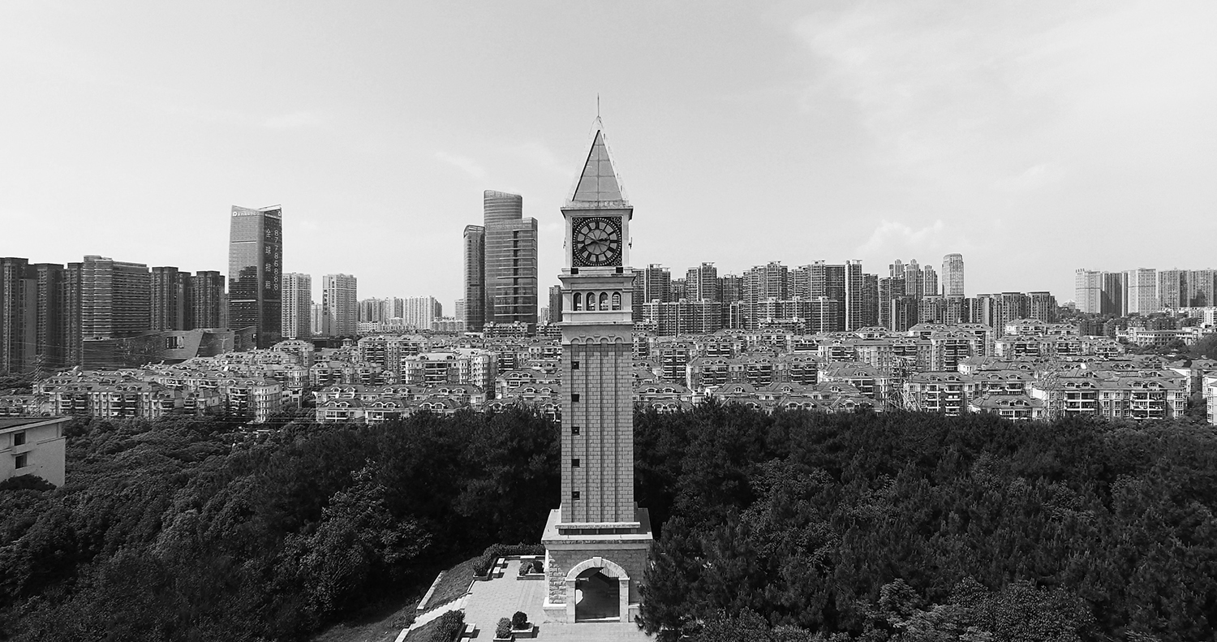
BUSINESS PLAN
20XX
谢谢！
The user can demonstrate on a projector or computer, or print the presentation and make it into a film to be used in a wider field The user can demonstrate

